Slide 1
ICTSKILLS ROBOTICS
Beni, Luca, Lara

Slide 2
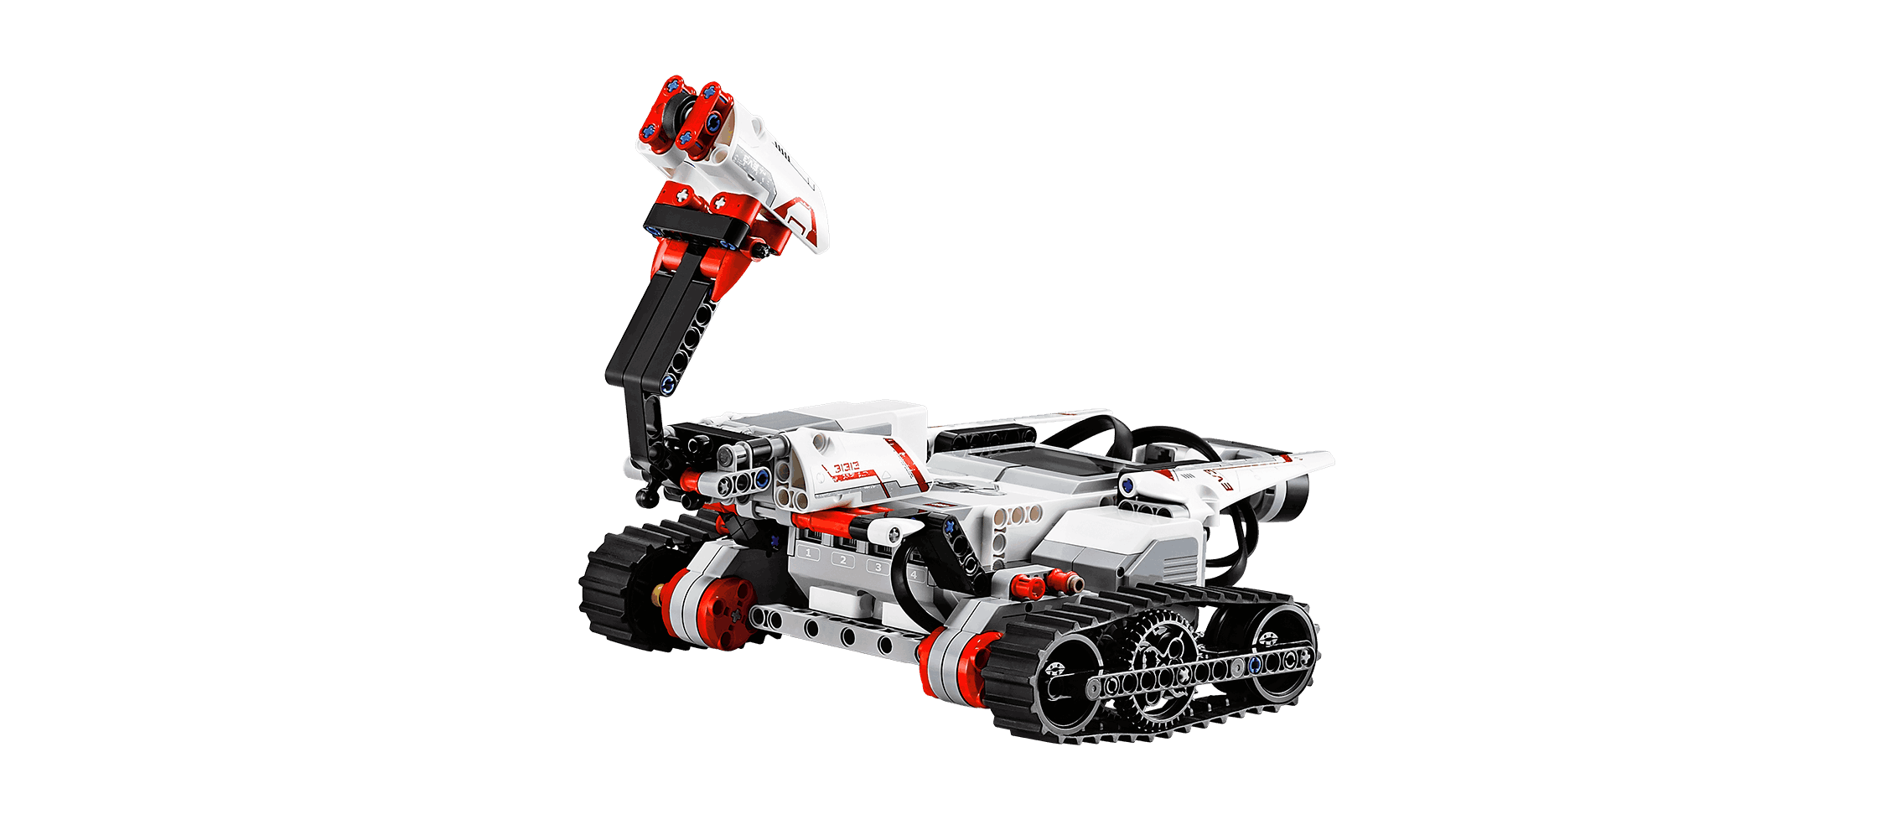
Level I
START
ENDE

Slide 3
Level II

Slide 4

Level III

